Slide 1
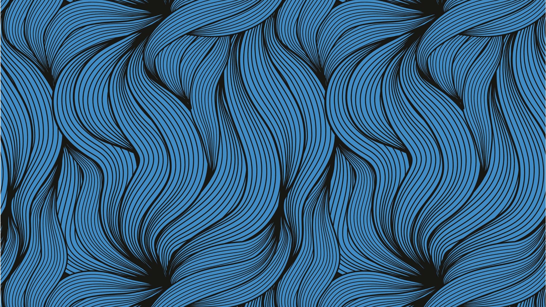
Learn to Dance Like an Ojibwe Jingle Dancer
Native American Heritage Month-Jingle Dancer by Cynthia Leitich Smith

Slide 2
Indigenous Storytime Tuesday Jingle Dancer by Cynthia Leitich Smith
-My Storytime was premiered on the Metropolitan Library System Facebook page on November 3rd. You can watch the Storytime by finding it on our Facebook page or you can copy and paste the link below.
https://www.facebook.com/metrolibrary/videos/3300161736776267/

Slide 3
History of the Jingle Dance
The Jingle Dress Dance originates from the Ojibwe tribe in the early 1900s.
During this time was the height of the Spanish Flu. The Spanish Flu had many similarities to our current issues with COVID-19. People were getting very sick and unfortunately it took time for scientists to figure out the disease.
The common origin story is that a medicine man had a very sick granddaughter and, in a dream,, he saw the jingle dress. The spirits told him to make this dress for her and she would be healed.
The jingle dress is named because of the small metal cones on the dress that make its trademark Jingle. At the time, all the cones had to be hand rolled from metal can lids. Now many people do still hand roll their jingle cones, but they can also be purchased as premade cones.
Most dances will move in a zig zag pattern because it represents life’s journey.

Slide 4
2016 Gathering of Nations Pow Wow Jingle Special
Jingle Dancers are always women, but they do have different age levels.
The Jingle Dance originated with the Ojibwe, but now indigenous women of various tribes are Jingle Dancers.
Oklahoma has several different Pow Wows every year, the most prominent one normally being Red Earth which occurs in the summer.

Slide 5
Now its your turn!
Use the attached video to learn the steps of the Jingle Dance.
Keep in mind that though the steps are simple the dance has a long history. The dress itself is also very important.
The Jingle Dance is for most people viewed as a dance of healing, thus it carries great importance.

